Slide 1



BEEF CATTLE
View in Power BI
Last data refresh:
8/16/2022 12:17:02 PM UTC
Downloaded at:
8/18/2022 12:05:42 PM UTC

Slide 2
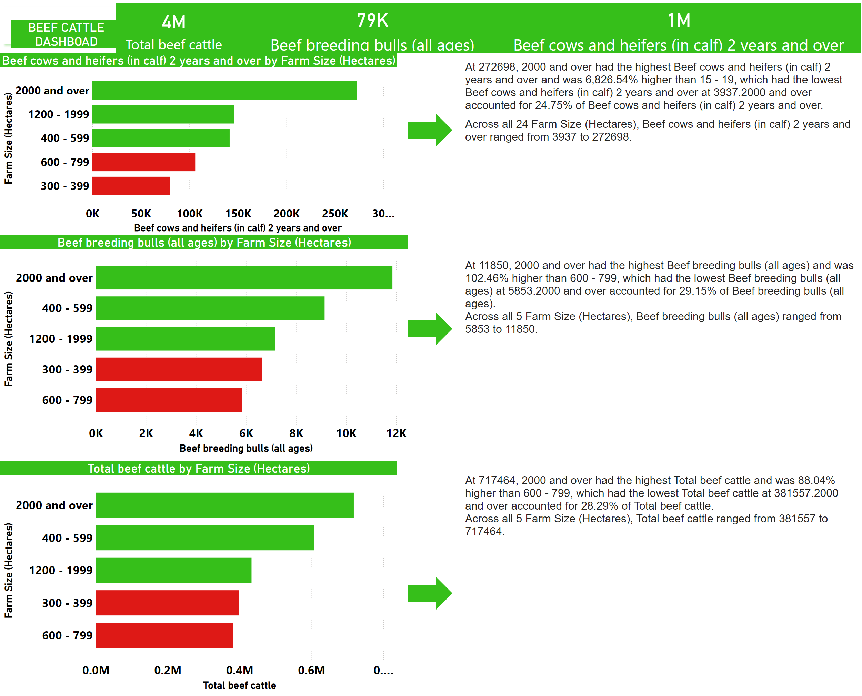
BEEF CATTLE REPORT
Notes:
shape
No alt text provided
textbox
No alt text provided
clusteredBarChart
No alt text provided
shape
No alt text provided
clusteredBarChart
No alt text provided
textbox
No alt text provided
card
No alt text provided
card
No alt text provided
TOTAL BEEF CATTLE
No alt text provided
BEEF CATTLE DASHBOAD
No alt text provided
shape
No alt text provided
shape
No alt text provided
textbox
No alt text provided
clusteredBarChart
No alt text provided

Slide 3
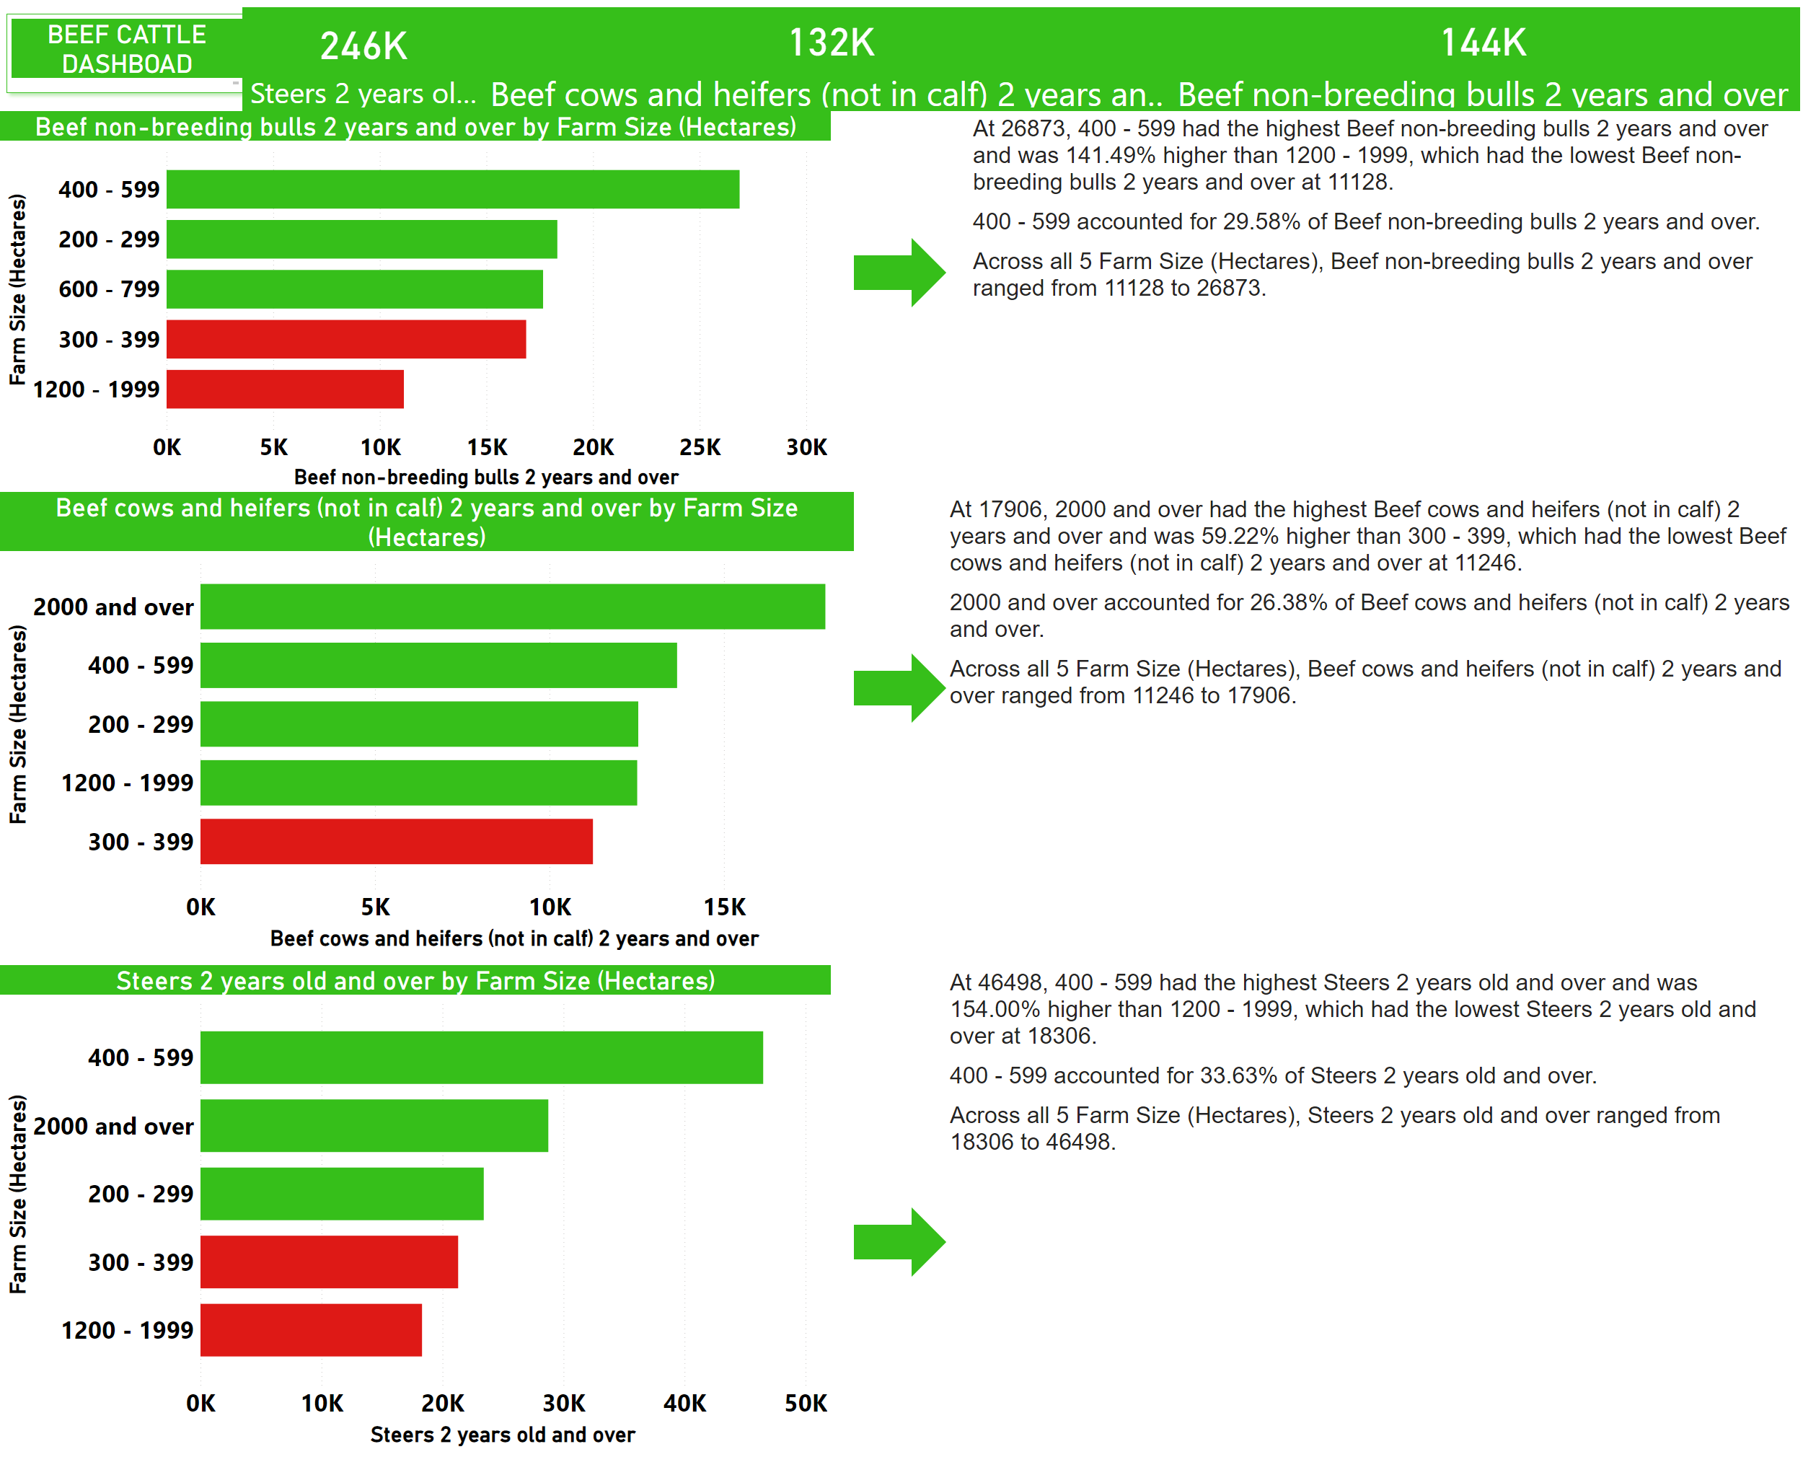
BEEF CATTLE REPORT
Notes:
shape
No alt text provided
textbox
No alt text provided
textbox
No alt text provided
textbox
No alt text provided
shape
No alt text provided
shape
No alt text provided
BEEF CATTLE DASHBOAD
No alt text provided
shape
No alt text provided
TOTAL BEEF CATTLE
No alt text provided
card
No alt text provided
card
No alt text provided
clusteredBarChart
No alt text provided
clusteredBarChart
No alt text provided
clusteredBarChart
No alt text provided

Slide 4
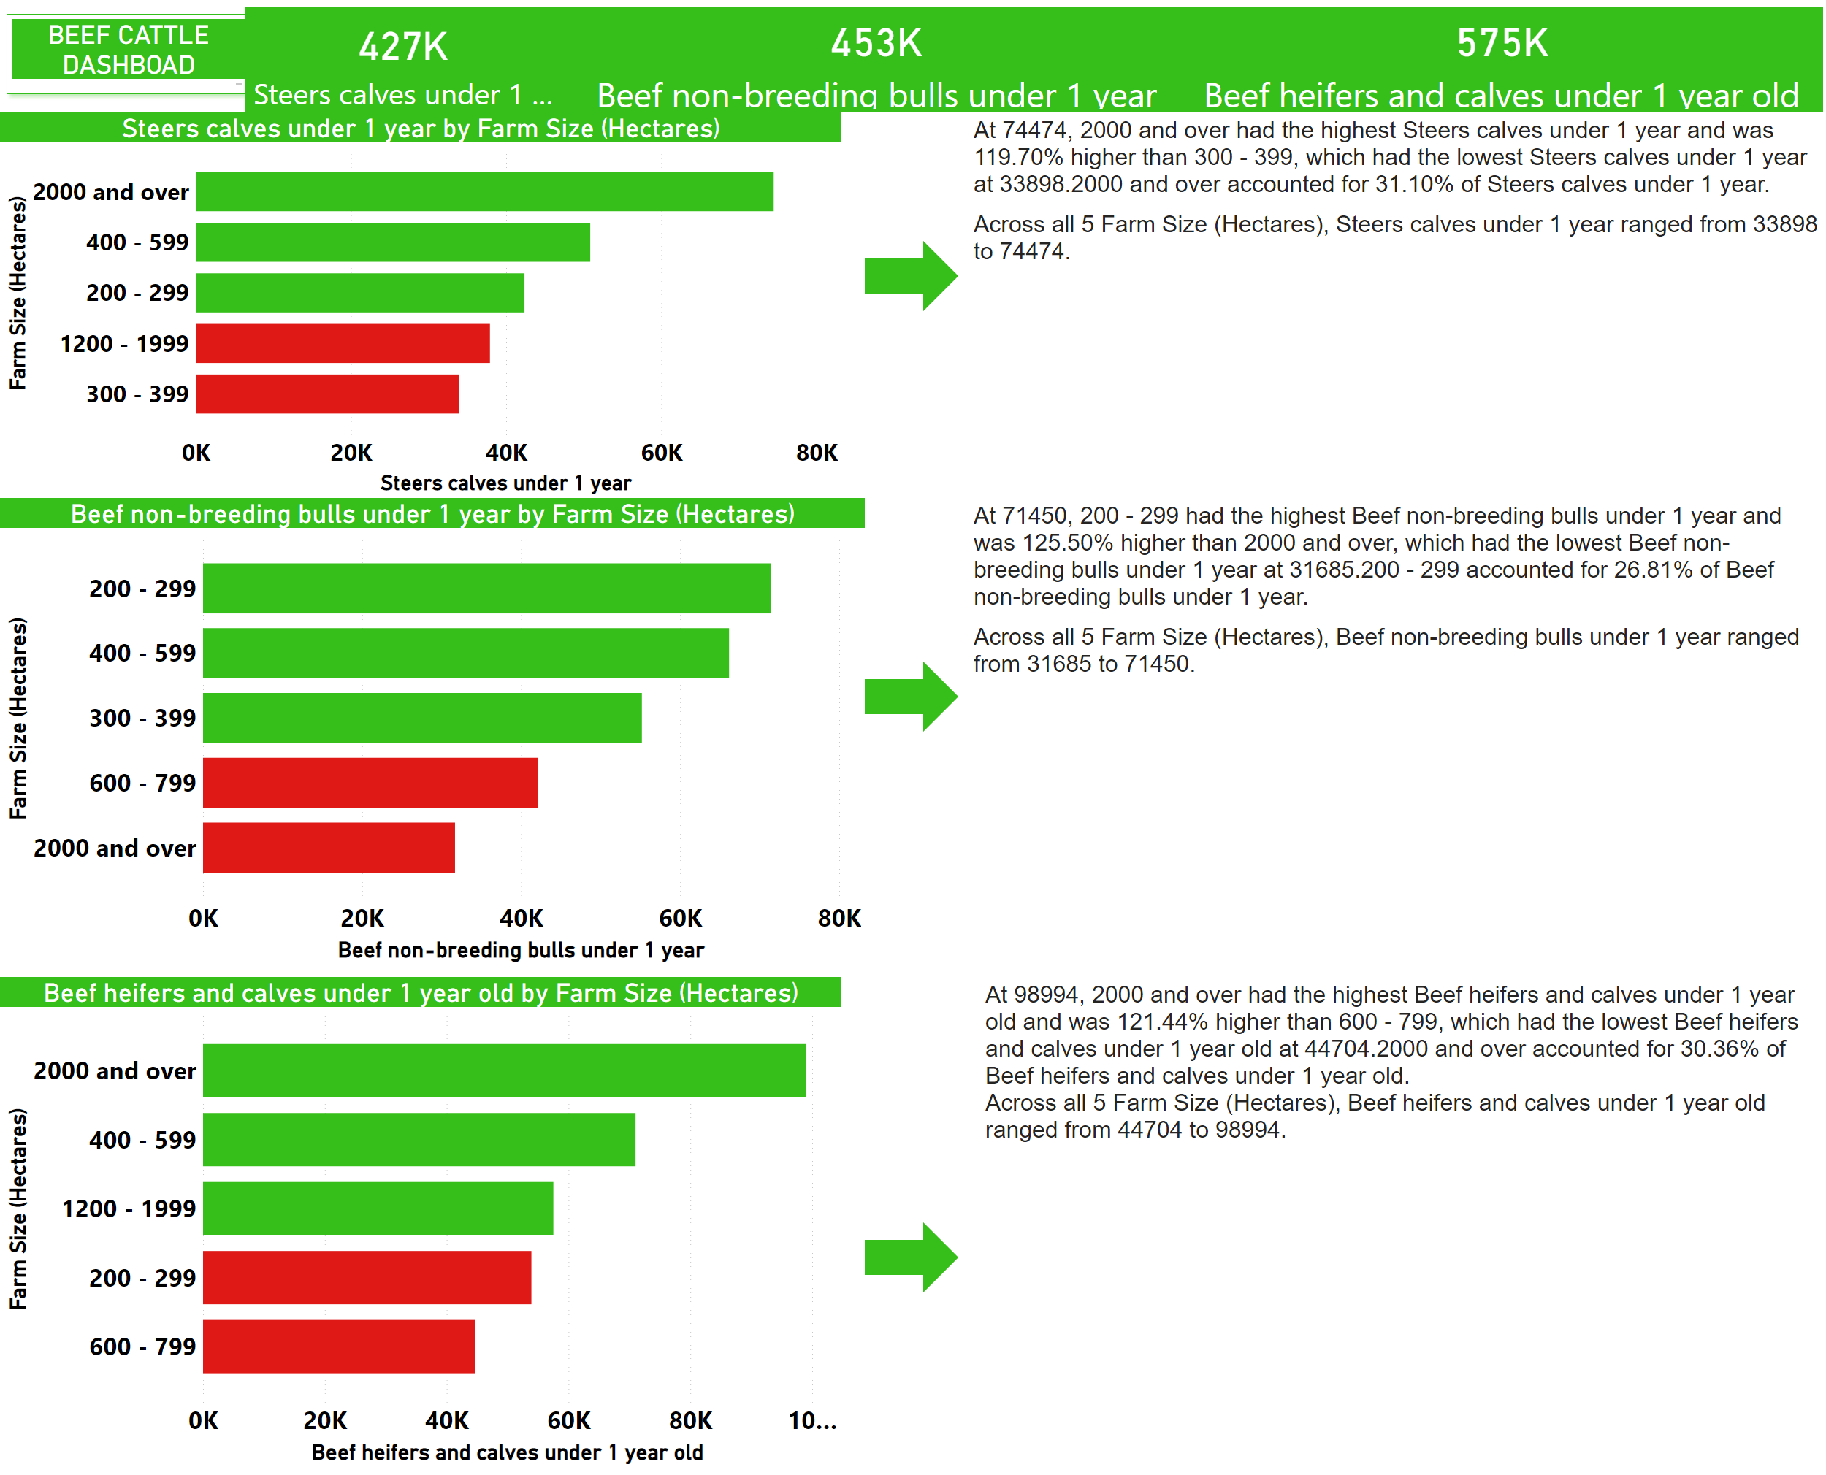
BEEF CATTLE REPORT
Notes:
shape
No alt text provided
BEEF CATTLE DASHBOAD
No alt text provided
shape
No alt text provided
shape
No alt text provided
shape
No alt text provided
card
No alt text provided
card
No alt text provided
TOTAL BEEF CATTLE
No alt text provided
clusteredBarChart
No alt text provided
clusteredBarChart
No alt text provided
clusteredBarChart
No alt text provided
textbox
No alt text provided
textbox
No alt text provided
textbox
No alt text provided

